Slide 1
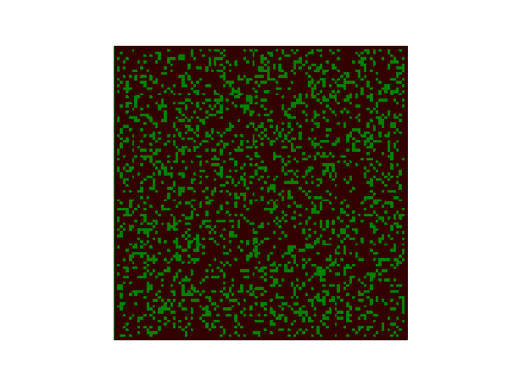
Cellular Automata
Fire Spread Model
Team:
Krunal Lukhi (201901449)
Dhwanil Shah (201901450)
Modeling and Simulation, CS302

Slide 2
Problem Statement
Our problem is to simulate the spread of fire from an initial landscape of empty ground, non-burning trees, and trees that are on fire.
Moreover, the area can suffer from lightning strikes, which may or may not start additional fires.
We would modify our model to study the effect of wind direction and its speed.

Slide 3
Important Terminology

Slide 4
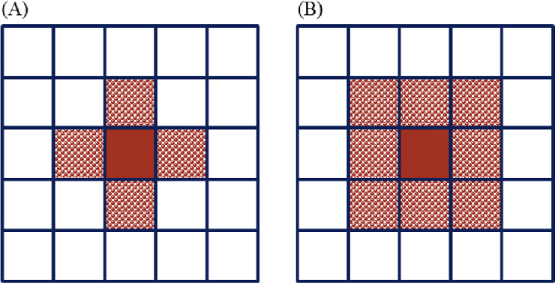
Neighborhood
https://www.researchgate.net/publication/326665499/figure/fig3/AS:653195516837889@1532745355875/Neighboring-type-in-cellular-automata-A-von-Neumann-configuration-B-Moor.png

Slide 5
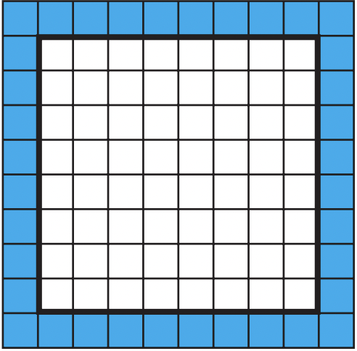
Absorbing Boundary Condition

Slide 6
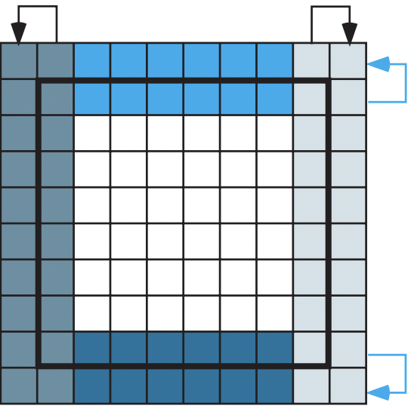
Reflective Boundary Condition

Slide 7
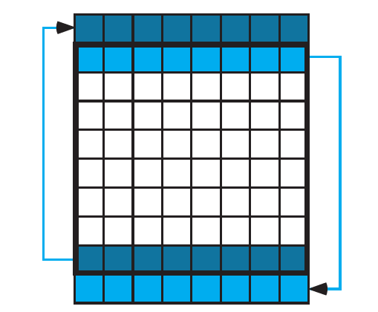
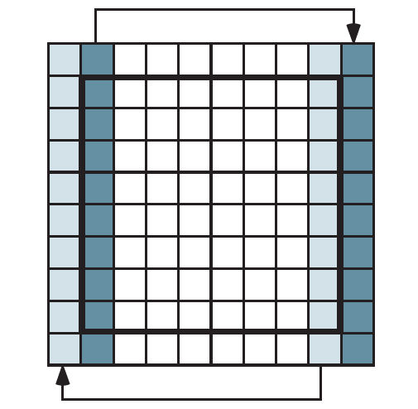
Periodic Boundary Condition

Slide 8
Implementation Detail

Slide 9
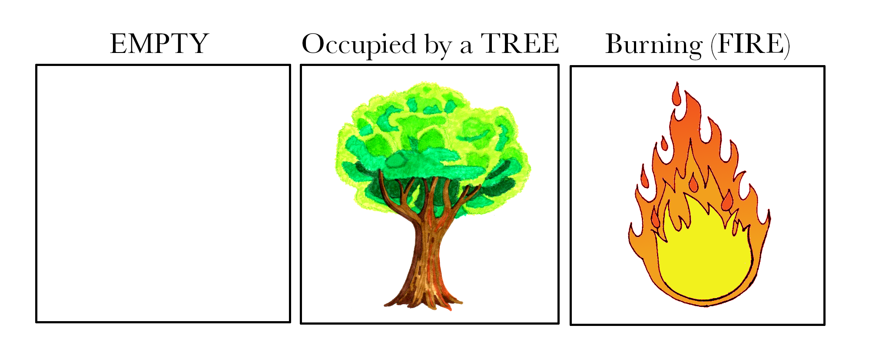
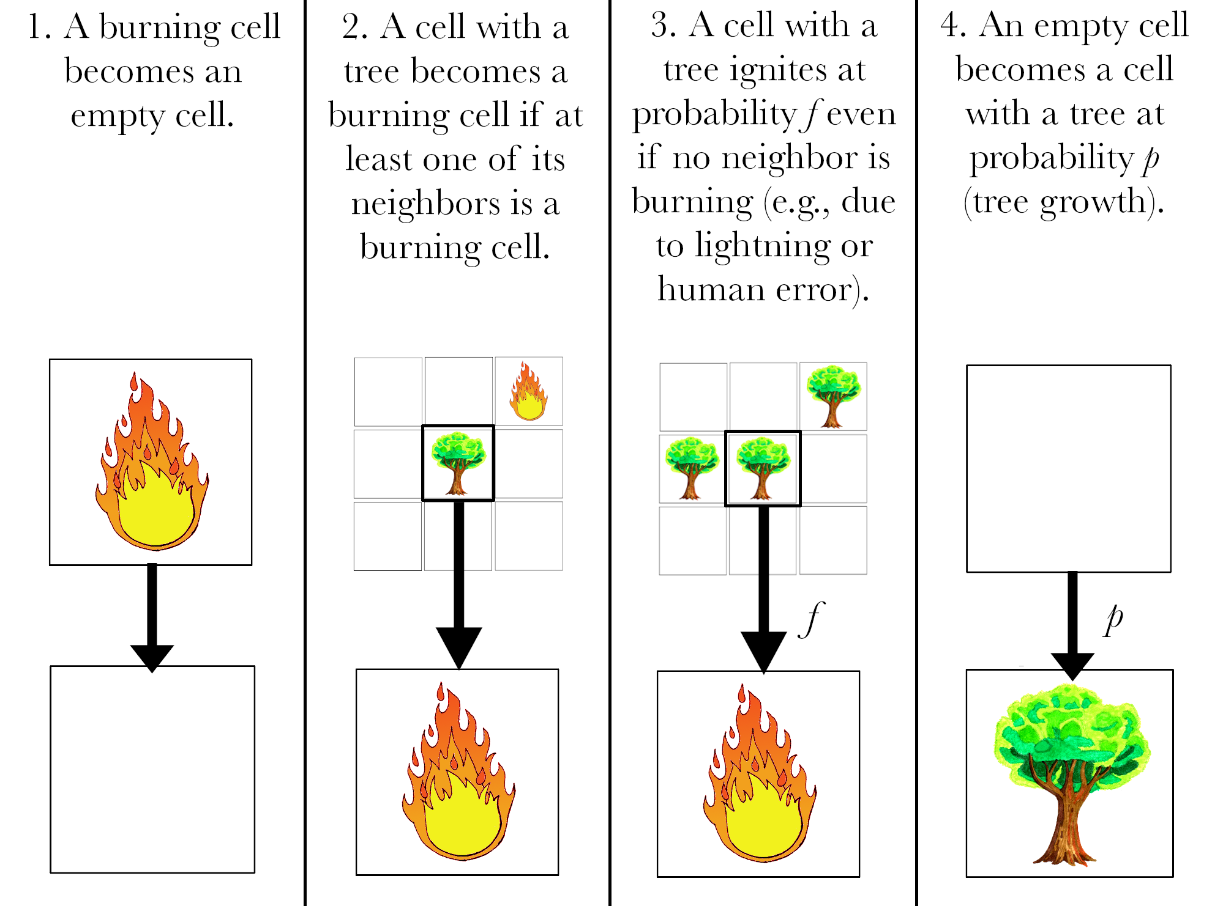
https://triplebyte.com/blog/how-fire-spreads-mathematical-models-and-simulators

Slide 10
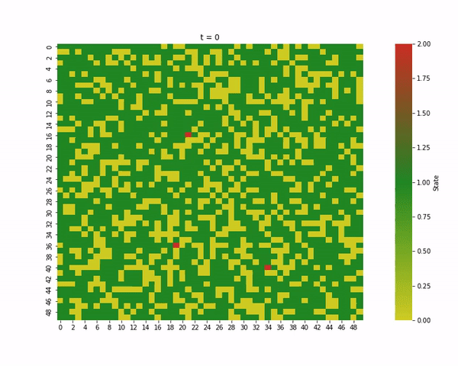
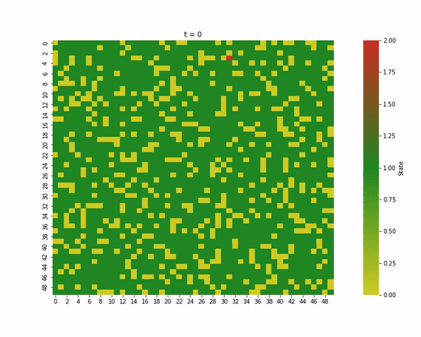
Varying Tree Density
Tree density = 0.7
Tree density = 0.8

Slide 11
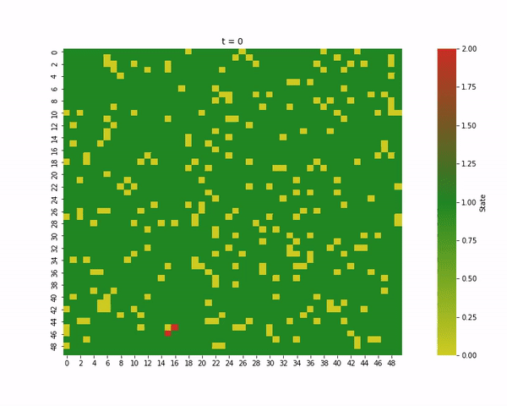
Tree density = 0.9

Slide 12
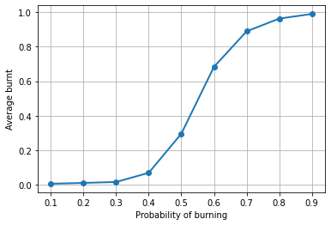
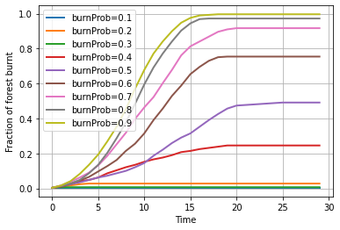
Varying Probability of Burning

Slide 13
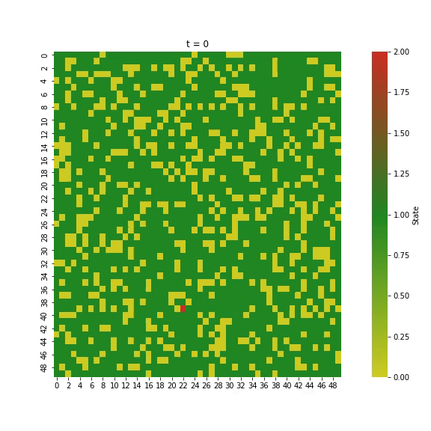
A tree taking 2 time steps to burn completely

Slide 14
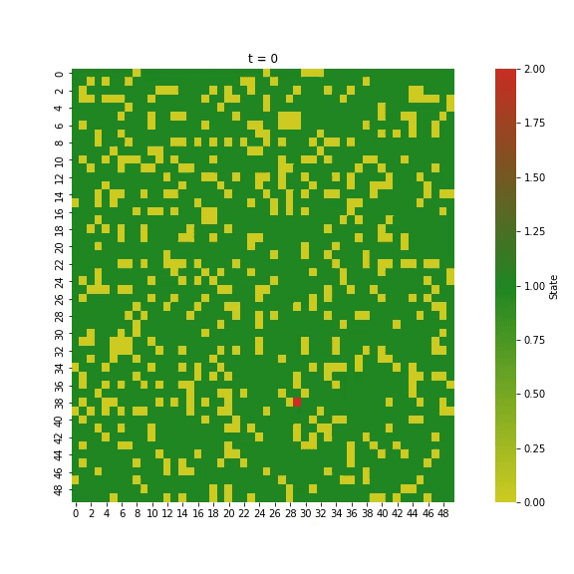
Neighborhood Dependent Probability

Slide 15
Effect of Wind

Slide 16
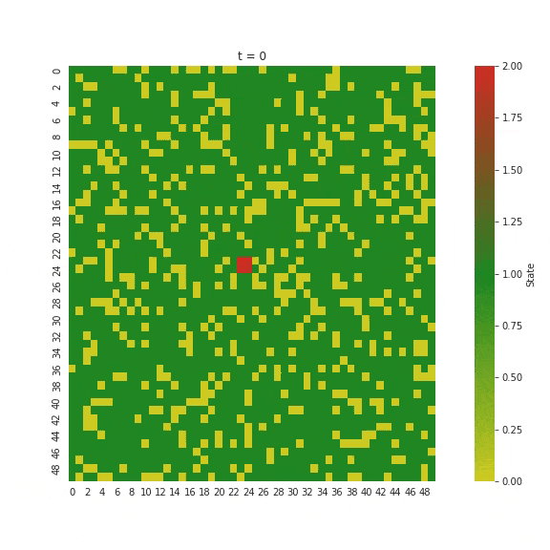
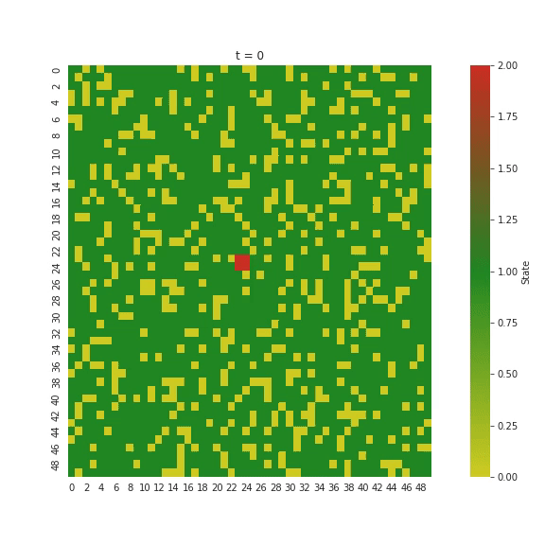
Varying Wind Direction
North
South

Slide 17
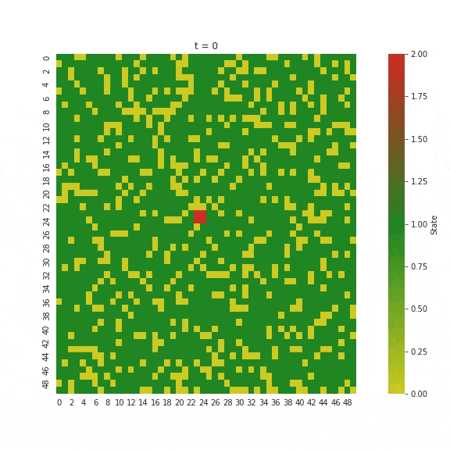
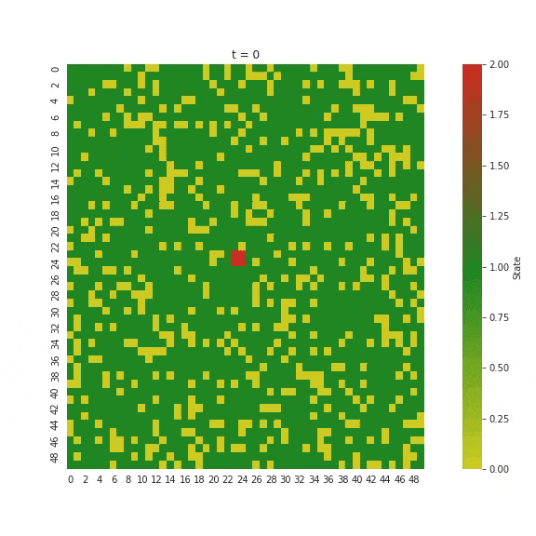
Varying Wind Direction
East
West

Slide 18
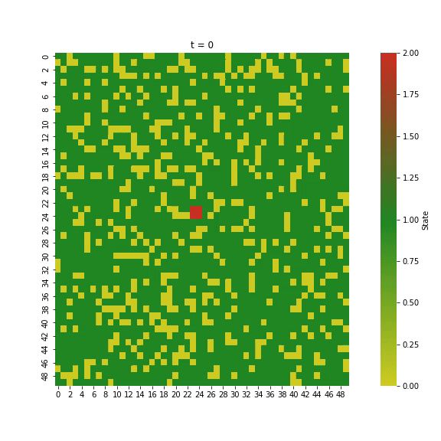
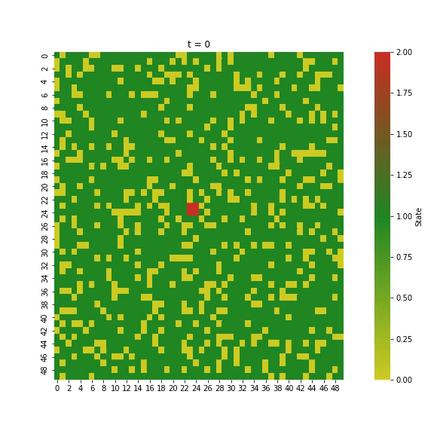
Varying Wind Level
No wind
Low wind

Slide 19
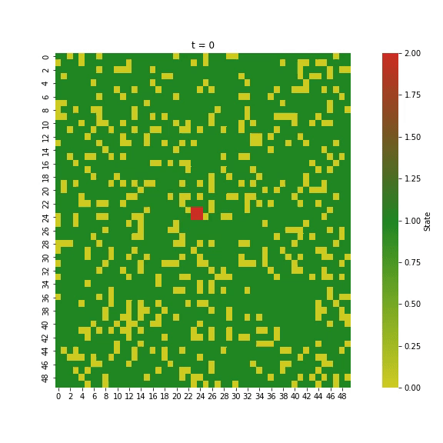
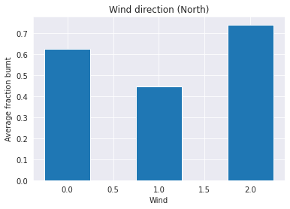
Varying Wind Level
High wind

Slide 20


